Slide 1
Chromecast and Roku
Developing for the Big Screen
Ben Von Handorf
ben@skyironstudio.com

Slide 2
Thanks to our sponsors

Slide 3
Who am I?
(or Why is he still talking?)
Developer
Android
Interested in unusual interaction patterns

Slide 4
Why develop for TVs?
TVs are ubiquitous
TVs are cheap
TVs are inherently multi-user
Notes:
More than 95% of US Households own at least 1 TV, 114m households.
Many TVs are in other environments: Airports, Waiting rooms, bars, etc.

Slide 5
Apps on TVs
Different Interaction Patterns
Different Attention
Different Platforms

Slide 6
Why Roku?
Among popular streaming devices
Developer Friendly
Low cost of entry

Slide 7
Why Chromecast?
VERY low cost of entry
Developer Friendly
Interesting interaction model

Slide 8
Why NOT Apple TV?
No public SDK (yet. been waiting for since 2007)

Slide 9
Why NOT Amazon Fire TV?
Android capabilities
It’s been out for 2 days
Notes:
Fundamentally just another Android TV device like OUYA
Android capabilities
It’s been out for 2 days, give me a break!

Slide 10
Why NOT Smart TVs?
No clear market leader
Not all have public SDKs
Strict review
Increased cost of entry
Notes:
Many manufacturers exercise strict control over what apps they will allow to be published on their TVs.
Cost of Entry: Price > Cheap TV + Roku/Chromecast

Slide 11
Why NOT <others/>?
Many players
60 minutes
Most interesting platforms

Slide 12
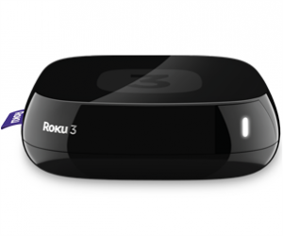
Roku Development
Slides for the Roku section of this presentation can be downloaded onto any Roku device by going to http://bit.ly/rokudev and adding the channel to your account.
Notes:
Image source, wikimedia

Slide 13
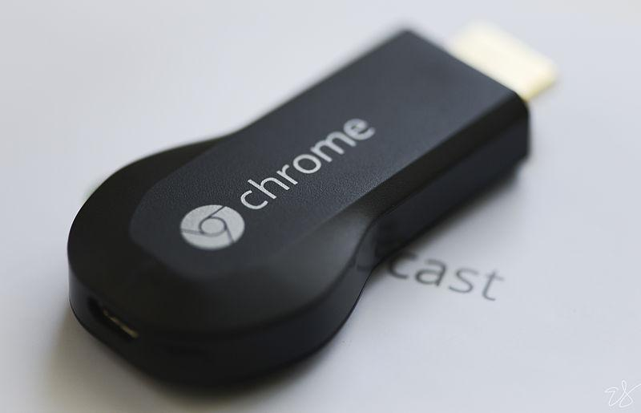
Chromecast
Notes:
Image source, wikipedia

Slide 14
Chromecast
Different use model
Notes:
Chromecast relies on a fundamentally different model of use and will require a different approach to development.

Slide 15
Chromecast Approach
TV becomes an accessory
No direct control mechanism
Notes:
Chromecast makes your TV into an accessory for your smartphone or web browser.
Unlike the Roku, there is no control mechanism built into the Chromecast… it is simply a way for web and mobile apps to display their content.

Slide 16
Cast API vs Chromecast
Google Cast API is not Chromecast specific.
Notes:
Google has put forward the Cast API as a general API. Right now, the Chromecast is the only “normal” device to implement the API (there are some hacked together solutions) but in the future other devices could work with it.
(A future version of Android TV, perhaps?)

Slide 17
Terminology
Sender App - The application that initiated the Cast API connection.
Receiver App - Javascript & HTML application running on the Chromecast.

Slide 18
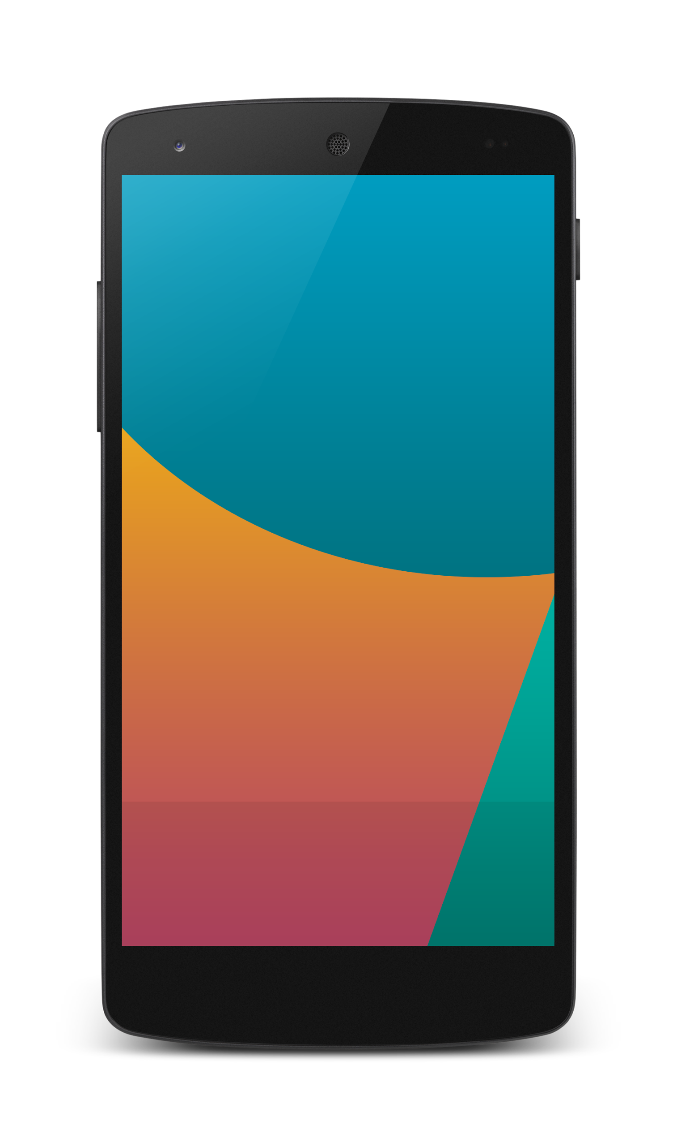



Discovering Chromecast
If a Chromecast is present, display

Slide 19


Connecting to a Chromecast
Websocket connection to application for control
Chromecast app downloaded
from the Internet
When Chromecast is connected, display

Slide 20
Who can write a Sender?
Sender SDKs:
Android
iOS
Chrome
Notes:
Basically anyone. Sender SDKs exist for:
Android - Cooked into the MediaRouter API
iOS
Chrome (via Javascript. Requires Chrome plug in. Could support other browsers in the future)

Slide 21
Typical Uses
Typical, obvious use cases for Chromecast include
Video (YouTube, Netflix)
Audio (Podcasts, Music)

Slide 22
Default & Styled Media Receiver
Google provided
Default Media Receiver
Styled Media Receiver
Notes:
Google provides a two simple Receiver apps for streaming audio & video:
Default Media Receiver - Doesn’t require you to register a Chromecast app.
Styled Media Receiver - Allows you to customize UI.

Slide 23
More Complicated Use Cases
Multiple senders, same receiver
Receivers can outlive senders
Notes:
With a custom Receiver App, the Chromecast can serve much more complicated roles.
A few notes to spark some ideas:
Receivers can accept connections from multiple senders.
Receivers don’t have to exit when the last client disconnects.

Slide 24
Preparing for Development
Check “Send this Chromecast’s serial number when checking for updates” in setup
Chromecast developer account ($5)
Notes:
To develop with a Chromecast, you must check “Send this Chromecast’s serial number when checking for updates” in the Chromecast setup application.
You must register for a Chromecast developer account to create receiver apps. ($5)

Slide 25
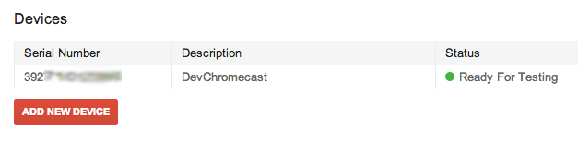
Register your Chromecast
Add S/N of Chromecast to Cast dev portal

Slide 26
Create a Chromecast Receiver App
Choose:
Custom Receiver or Styled Media Receiver
Name
Platform(s)
File locations
For Styled Media Receiver, CSS location
For Custom Receiver, app location

Slide 27
Publishing a Receiver
Pre-publishing, receiver only works on your registered Chromecasts.
Publishing requires an https URL.
After publishing, available to all Chromecasts.
Notes:
Until the app is published, your app will only work on Chromecasts registered on your account.
Publishing requires the files to be hosted on an https URL.
Once an app is published, it is available to all Chromecast users.

Slide 28
Developing a Sender App
Sender initializes the API
API notifies sender of Cast availability
Sender requests the launch of an Receiver App Id
API notifies sender of Session start
Notes:
Varies from platform to platform, but the underlying concepts are the same.

Slide 29
Interview with a Receiver
Message bus connects Sender and Receiver.
Messages are scoped to Namespaces
Built in Media namespace
Custom messages are free-form
Notes:
Sender and Receiver are connected via a message bus (over websockets) .
Messages are scoped to a Namespace, and each namespace can be handled separately.
There are predefined messages for media control, your own messages are entirely up to you.

Slide 30
For Chrome Sender App Dev
The Chromecast plugin will not load for file:// files. You must deploy your files to a web server and access them there.

Slide 31
Debugging Receiver Apps
Chrome development tools are available by going to http://<ip of chromecast>:9222/
You will then have access to a full Javascript console and all the other Chrome debugging goodness you’re used to.
console.log(...) will even be written here, along with a lot of Chromecast info logs.

Slide 32
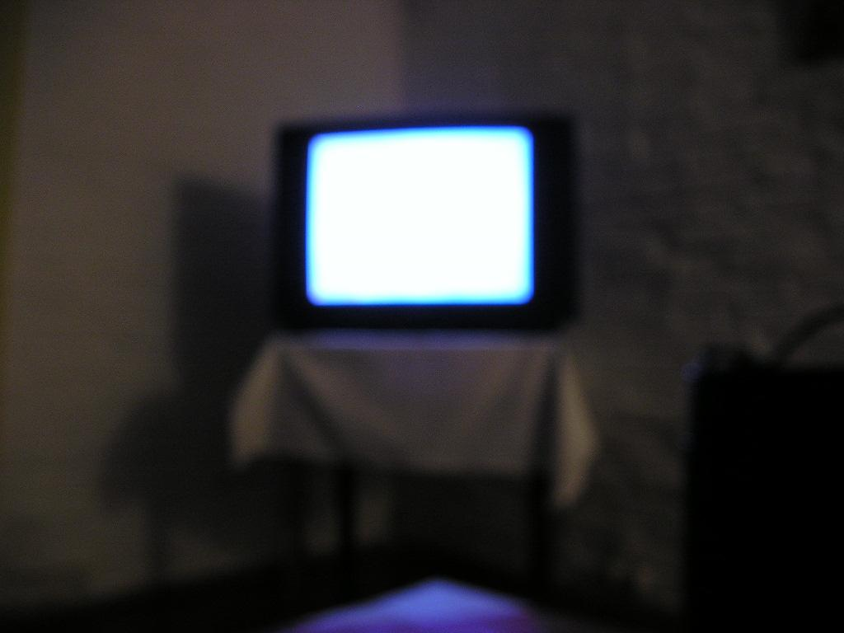
General TV Development

Slide 33
TV Development Guidelines
10 foot experience
Big fonts
Minimal text
Authentication stories
OAUTH
Roku’s authentication flow
Notes:
10 foot experience
Big fonts
Minimal text
Authentication stories
Leverage OAUTH or Roku’s authentication flow to make this process as painless as possible

Slide 34
Media Formats
Different devices, different codecs
Notes:
Smart TV devices all support different ranges of codecs and containers. Do your research!

Slide 35
Further Resources
Roku SDK Documentation http://sdkdocs.roku.com/
Roku Developer Program http://www.roku.com/developer
Google Cast Developer Site
https://developers.google.com/cast/

Slide 36
Thanks for your time!
Enjoy the rest of the conference!
Ben Von Handorf
@benvonhandorf
ben@skyironstudio.com
http://bit.ly/chromecast_roku
Questions?

